Slide 1
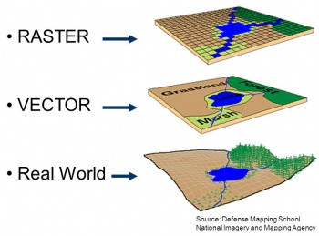
geographic information system (GIS) intro
Ian Liu
https://www.esri.com/en-us/what-is-gis/overview

Slide 2
What is GIS
A technology used to collect, store, analyze, manage, and visualize geographic data.
Two forms of geographic data: 1. Vector Data 2. Raster Data
Attribute data: additional descriptive information about the features represented in both vector and raster data.
Data formats
How to accurately represent geographic data? coordinate systems (CRS)
How to store geographic data? Well-Known Text(WKT)

Slide 3
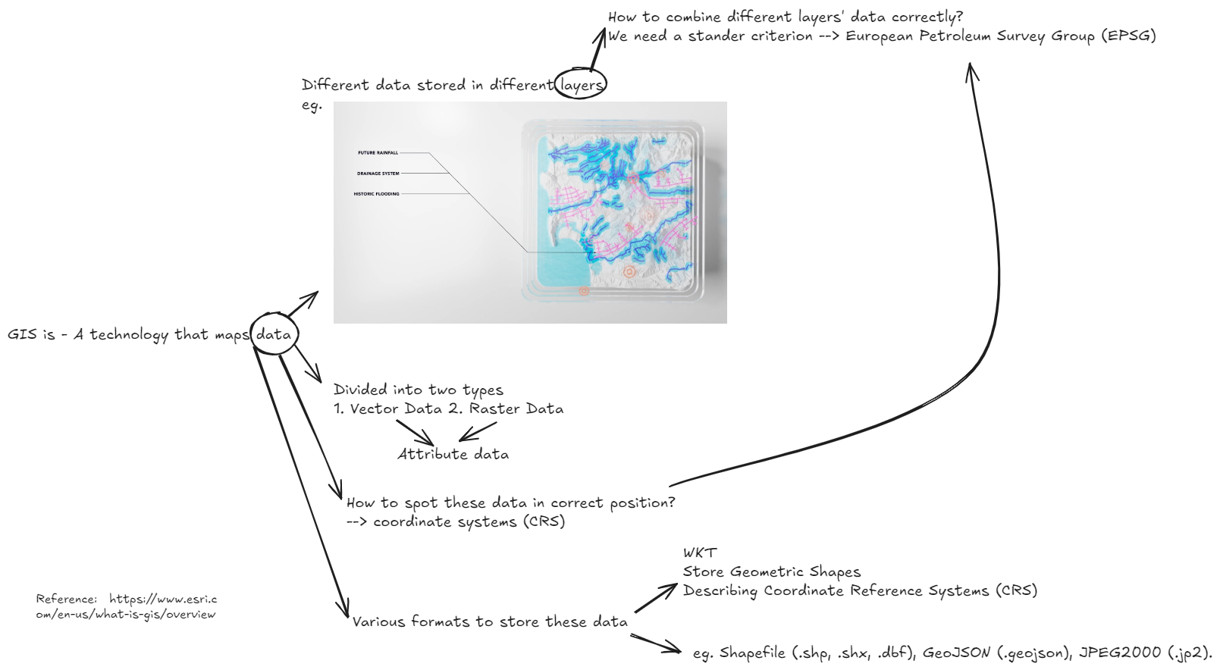

Slide 4
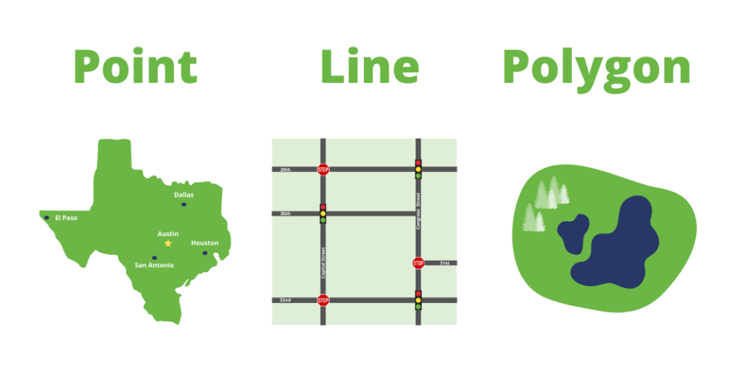
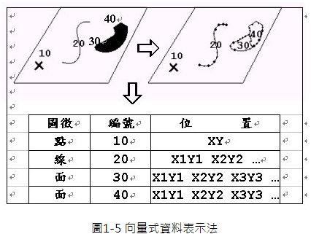
Vector Data
Vector data
Point Data: Represents specific locations (e.g., a city, a tree).
Line data: Represents linear features (e.g., roads, rivers).
Polygon Data: Represents area features (e.g., lakes, political boundaries).
Attribute data for vector data:
Ex: school’s name, type, number of students
https://id.land/blog/raster-vs-vector-data-the-ultimate-guide
https://www.gimtech.com.tw/gimtech_summary_1_4.html

Slide 5
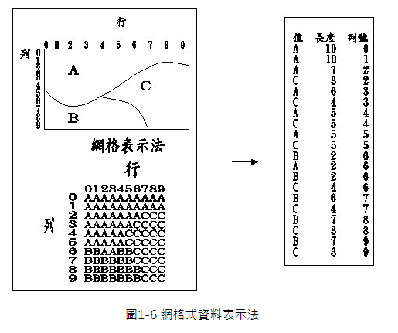
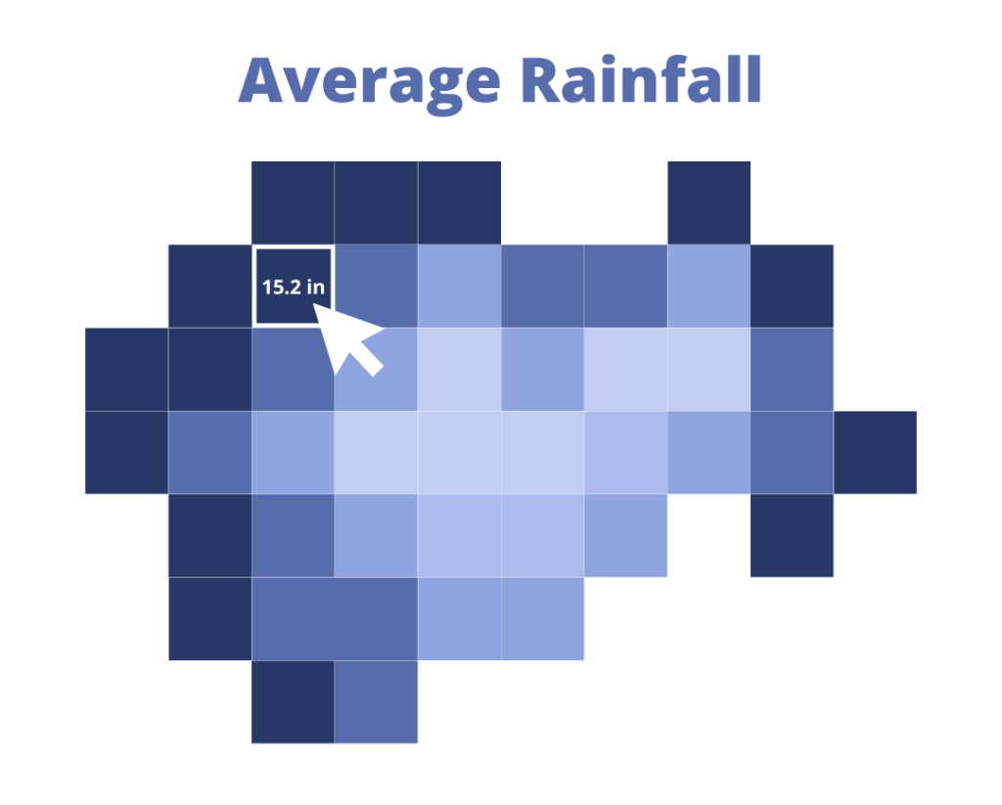
Raster data
Raster Data
Grid Cells/Pixels: Each cell has a value representing a continuous phenomenon, like elevation, temperature, or land cover.
Attribute data for Raster data:
Ex: indicating whether the land is forest, water, urban
Reference: https://id.land/blog/raster-vs-vector-data-the-ultimate-guide
https://www.gimtech.com.tw/gimtech_summary_1_4.html

Slide 6
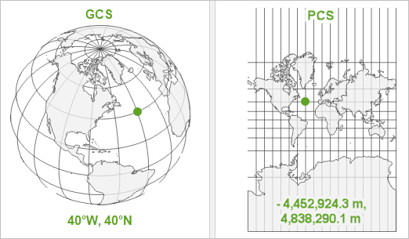
coordinate systems (CRS)
Two types of CRS:
1. Geographic Coordinate System (GCS) : Uses latitude and longitude to define locations on the Earth's surface.
2. Projected Coordinate System (PCS): Transforms the Earth's curved surface into a flat, two-dimensional plane using map projections.
Reference: https://www.esri.com/arcgis-blog/products/arcgis-pro/mapping/gcs_vs_pcs/

Slide 7
European Petroleum Survey Group (EPSG)
a widely recognized standard for identifying and describing CRS
including geographic coordinate systems, projected coordinate systems, vertical datums etc.
Common EPSG Codes
EPSG:4326: This is the code for the WGS 84 geographic coordinate system, which uses latitude and longitude to represent global positions. It is the basis for the Global Positioning System (GPS).
EPSG:32633: This code represents the WGS 84 UTM zone 33N projected coordinate system, used for mapping regions between longitudes 12°E and 18°E.
WGS84 :World Geodetic System 1984

Slide 8
GIS data format
Well-Known Text (WKT)
Uses of WKT : describe geometric shapes & parameters of a coordinate reference system (CRS)
human-readable format
Others: Shapefile, GeoJSON, KML/KMZ etc.
Vector data, Raster data
WKT is primarily a text format used to describe geometry and CRS, useful for embedding within other systems or databases.

Slide 9
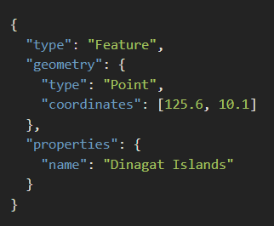
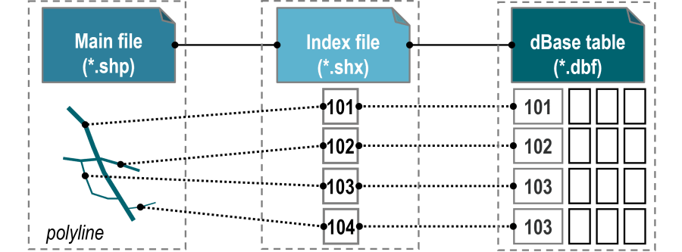
Data format – vector data
Data format: Shapefile (.shp, .shx, .dbf), GeoJSON (.geojson), KML/KMZ (.kml, .kmz), GPKG (GeoPackage), File Geodatabase (.gdb), etc.
Geojson
Shapefile
The three required files are:
–SHP is the feature geometry. –SHX is the shape index position. –DBF is the attribute data.
https://ithelp.ithome.com.tw/articles/10193701?sc=rss.iron
https://transportgeography.org/contents/methods/network-data-models/esri-shapefile-model/

Slide 10
Data format – raster data
Data format: GeoTIFF (.tif, .tiff), JPEG2000 (.jp2), Erdas Imagine (.img), NetCDF (.nc), etc.
Example GeoTIFF Metadata
Width: 1024 pixels
Height: 768 pixels
Coordinate Reference System (CRS): EPSG:32633 (UTM Zone 33N, WGS 84)
Upper Left Corner: (500,000 m Easting, 4,650,000 m Northing)
Pixel Size: (30 m x 30 m)
Band Count: 3 (for a color image with Red, Green, Blue bands)

Slide 11
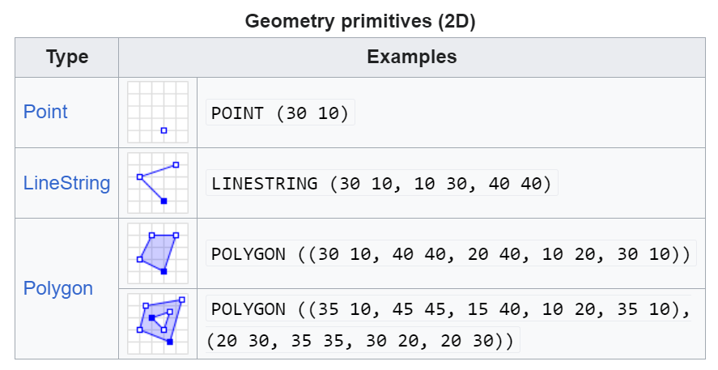
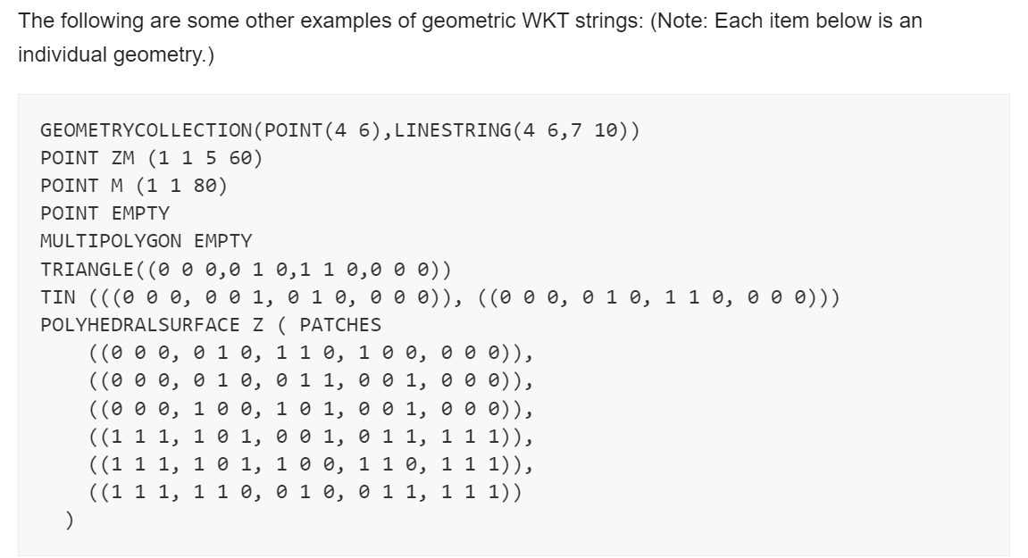
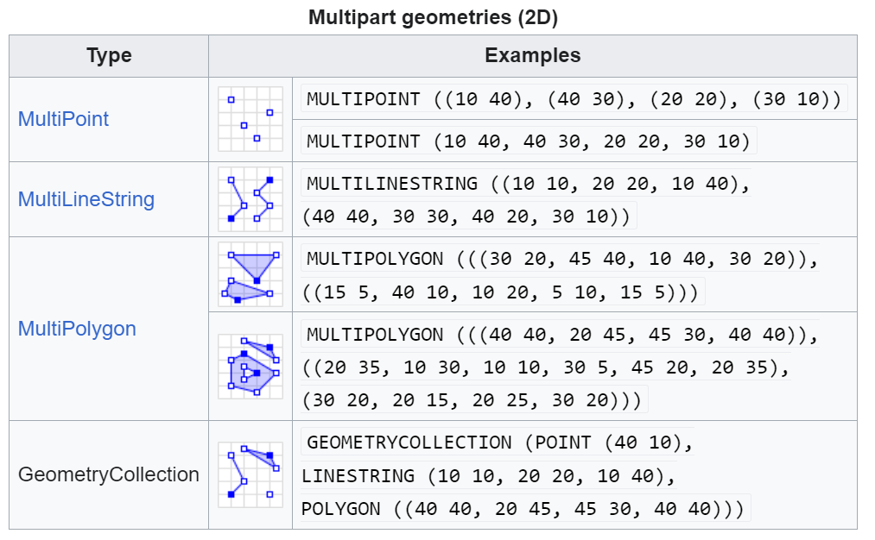
Well-Known Text (WKT) - Describing Geometric Shapes
polygon前後的點要閉合
A cube
Z: Z coordinate (elevation)
M: a measure, which can represent time, distance, or other quantities
POINT EMPTY: there is no point data
TIN: This stands for Triangulated Irregular Network, a collection of triangles that model a surface in 3D space.(eg. Mountain)
https://en.wikipedia.org/wiki/Well-known_text_representation_of_geometry

Slide 12
Well-Known Text (WKT) - Describing Coordinate Reference Systems (CRS)
GEOGCS (Geographic Coordinate System)
GEOGCS["WGS 84",
DATUM["WGS_1984",
SPHEROID["WGS 84", 6378137, 298.257223563]],
PRIMEM["Greenwich", 0],
UNIT["degree", 0.0174532925199433]]
Datum（基準）：定義座標系統的原點和方向，通常與特定的橢球體相連。
Spheroid（橢球體）：用於近似地球形狀的模型，由其半長軸和扁率來定義。
Prime Meridian（本初子午線）：定義經度的起點，通常為格林威治本初子午線。
Angular Units（角度單位）：通常是度，定義座標的測量單位。
WGS 84：這是所使用的地理座標系統。
DATUM["WGS_1984"]：使用WGS 1984基準，包含：
SPHEROID["WGS 84", 6378137, 298.257223563]：所使用的橢球體模型，半長軸為6378137米，扁率為298.257223563。
PRIMEM["Greenwich", 0]：定義經度0度的本初子午線為格林威治。
UNIT["degree", 0.0174532925199433]：測量單位為度（每度0.0174532925199433弧度）。
Notes:
定義一個地理座標系統

Slide 13
Well-Known Text (WKT) - Describing Coordinate Reference Systems (CRS)
2. PROJCS (Projected Coordinate System)
PROJCS["UTM Zone 33N",
GEOGCS["WGS 84",
DATUM["WGS_1984",
SPHEROID["WGS 84", 6378137, 298.257223563]],
PRIMEM["Greenwich", 0],
UNIT["degree", 0.0174532925199433]],
PROJECTION["Transverse_Mercator"],
PARAMETER["latitude_of_origin", 0],
PARAMETER["central_meridian", 15],
PARAMETER["scale_factor", 0.9996],
PARAMETER["false_easting", 500000],
PARAMETER["false_northing", 0],
UNIT["metre", 1]]
GEOGCS：基礎的地理座標系統。
Projection（投影）：所使用的地圖投影方式，例如橫麥卡托投影、阿爾伯斯等積投影等。
Parameters（參數）：定義投影所需的具體參數，如中央經線、標準緯線、比例因子、假東距和假北距等。
Linear Units（線性單位）：投影的測量單位，通常是米。
PROJCS["UTM Zone 33N"]：定義一個投影座標系統，針對UTM第33N區。
GEOGCS：基礎地理座標系統為WGS 84。
PROJECTION["Transverse_Mercator"]：使用橫麥卡托投影。
PARAMETER["latitude_of_origin", 0]：起始緯度為赤道（0度）。
PARAMETER["central_meridian", 15]：中央經線設定在15°E。
PARAMETER["scale_factor", 0.9996]：縮放因子，用來減少投影變形。
PARAMETER["false_easting", 500000]：假東距500000米，用來避免負座標。
PARAMETER["false_northing", 0]：假北距設為0，適用於北半球UTM區域。
UNIT["metre", 1]：測量單位為米。
//epsg.io/32633.wkt

